Slide 1

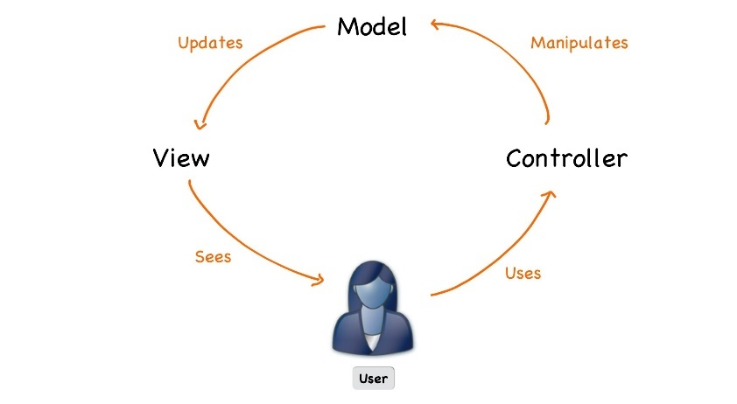


Java Web Development Basics
Course Introduction
SoftUni Team
Technical Trainers
Software University
http://softuni.bg
Notes:
© Software University Foundation – http://softuni.org
This work is licensed under the Creative Commons Attribution-NonCommercial-ShareAlike license.
<number>

Slide 2
Table of Contents
Course Objectives & Program
The Trainers Team
Course Organization
Homework
Exam
Resources
<number>
Notes:
© Software University Foundation – http://softuni.org
This work is licensed under the Creative Commons Attribution-NonCommercial-ShareAlike license.
<number>

Slide 3
Questions
sli.do #java-web

Slide 4

Course Objectives & Program
Java Web Basics

Slide 5


Java Web Dev Basics – Course Program
Course Introduction – Course Program, Trainers, Exams,
Resources
Web Fundamentals Introduction: HTML & CSS
HTTP Protocol – HTTP Protocol Intro, Requests, Responses
State Management – Cookies & Sessions
Introduction to Java EE – What is Java EE?
Java EE: Servet API
<number>

Slide 6



Java Web Dev Basics – Course Program (2)
Java EE: JavaServer Pages – What are JSPs?
Java EE: Workshop – Web app with Servelts, JSPs and JPA.
Java EE: JavaServer Faces – What is JSF?
Java EE: JavaServer Faces – Libraries, Tags and Templates – What are JSF libraries, tags and templates?
Java EE: Workshop – Web app with JSF and JPA.
Exam Preparation
<number>

Slide 7

The Trainers Team

Slide 8
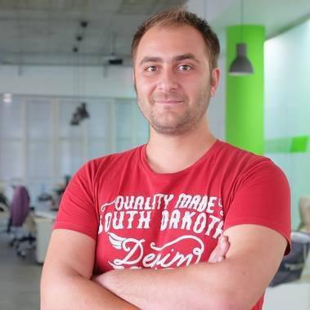
Trainers Team
Doncho Minkov
Senior Full Stack Developer in SoftUni
10+ years in IT
8+ years of experience as a
Technical Trainer @ Telerik Academy
Front-end developer by heart
Software developer by need
Experience with all popular mobile platforms
Android, iOS, Windows
Fluent in Node.js, .NET, Angular, Java, C++
"30 under 30" – Forbes 2017
<number>

Slide 9
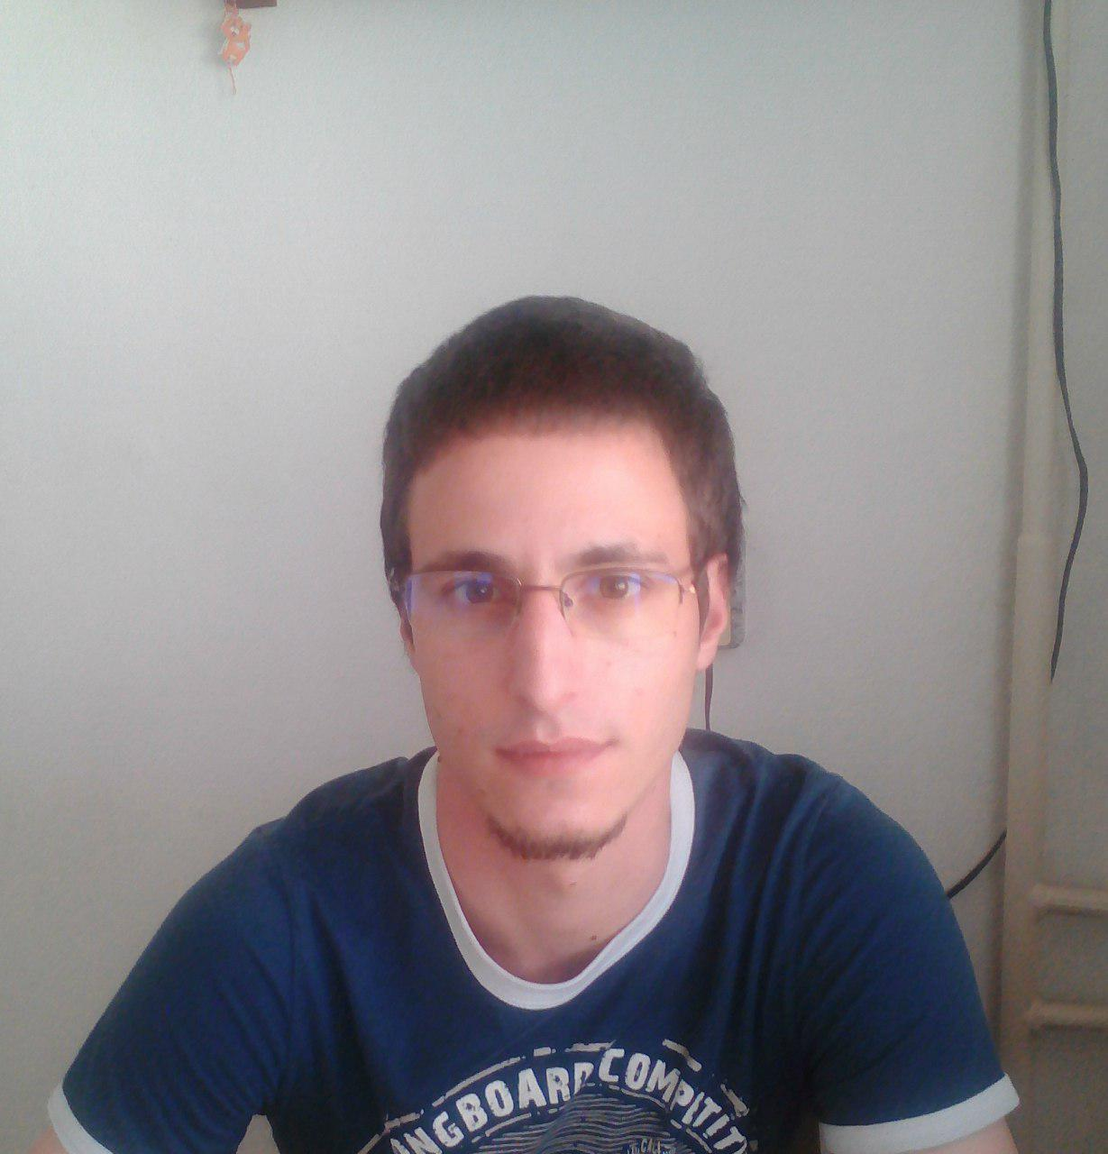
Trainers Team
Radoslav Evgeniev
Technical Trainer @ SoftUni
Java Web Developer
Experience with Spring Framework
and Java EE
Interested in self-development
<number>

Slide 10

Course Organization

Slide 11
Java Web Module at SoftUni – Timeline
14-Jan-2019
24-Feb-2019
14-Apr-2019
Java Web Development Basics
Lessons + exercises + exam
6 weeks * 4 times / week
12 credits
Start: 14-Jan-2019
Exam: 24-Feb-2019
Java MVC Frameworks
Lessons + exercises + exam
6 weeks * 4 times / week
18 credits
Start: 25-Feb-2019
Project Defense: 14-Apr-2019
Java Web Re-Take Exams
Third and forth week of April 2019

Slide 12



Scoring System for the Course
Presence in class 5%
Homework 15%
Evaluation
Forum Activity 5%
Exam 85%

Slide 13

Homework Assignments & Exercises
Your homework is mainly work in class!
Lesson days → slides + live demos + exercises
Exercise days → only exercises
How to submit your homework?
Submitted on the course page in softuni.bg
Exam
<number>

Slide 14

Exam
Practical web development exam
Implementing a simple web application using Java EE
specifications
Given a portion of the Views in a raw form
Duration: 6 hours.
Solutions are evaluated by hand after the exam
<number>

Slide 15
Resources
Resources
What We Need Additionally?

Slide 16



Java DB Course Web Site, Forum and FB Group
Official web site:
Official discussion forum:
Official Facebook groups
https://softuni.bg/trainings/2252/java-web-development-basics-january-2019
https://softuni.bg/forum/categories/73/java-web-development-basics
https://www.facebook.com/groups/JavaWebJanuary2019/
<number>
Notes:
<number>

Slide 17


The DB Basics MySQL Slides and Videos
All lecture slides, videos, homework assignments, projects and other resources are open content, available for free
Visit the course web site to access the course resources
<number>

Slide 18



Learn to Search in Internet
The course assignments require to search in Internet
This is an important part of the learning process
Some exercises intentionally have no hints
Learn to find solutions!
Software development includes everyday searching and learning
No excuses, just learn to study!
<number>

Slide 19
https://softuni.bg/trainings/courses
Notes:
© Software University Foundation – http://softuni.org
This work is licensed under the Creative Commons Attribution-NonCommercial-ShareAlike license.
<number>

Slide 20












SoftUni Diamond Partners

Slide 21




SoftUni Organizational Partners

Slide 22




Trainings @ Software University (SoftUni)
Software University – High-Quality Education and Employment Opportunities
softuni.bg
Software University Foundation
http://softuni.foundation/
Software University @ Facebook
facebook.com/SoftwareUniversity
Software University Forums
forum.softuni.bg
Notes:
© Software University Foundation – http://softuni.org
This work is licensed under the Creative Commons Attribution-NonCommercial-ShareAlike license.
<number>

Slide 23

License
This course (slides, examples, demos, videos, homework, etc.) is licensed under the "Creative Commons Attribution-NonCommercial-ShareAlike 4.0 International" license
<number>
Notes:
© Software University Foundation – http://softuni.org
This work is licensed under the Creative Commons Attribution-NonCommercial-ShareAlike license.
<number>

